Slide 1

UIIT Management System
Group Members:
Sahil Ashfaq (19-Arid-852)
Hamza Tanveer (19-Arid-801)
Muhammad Shoaib (19-Arid-839)

Slide 2
Problem Statement
Our university has University Portal that is dealing with all student and teacher related services but it’s not updating time-to-time and not user friendly.

Slide 3
Proposed Solution
We’ve tried to build a system that is up-to-date and user friendly.
Our system has a homepage due to which user can navigate through all functionality in a single go.

Slide 4
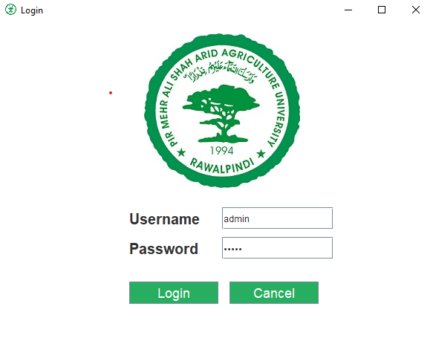
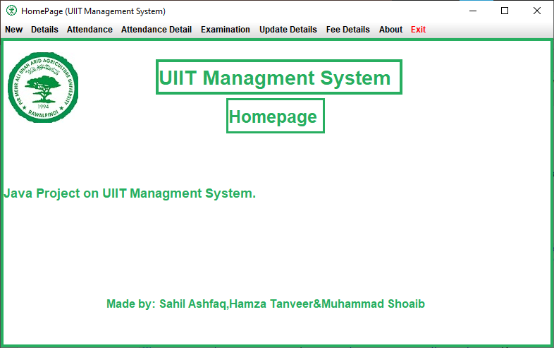
System’s Functionality
Login as Admin Homepage(Menu Bar to navigate through system)
Datab (cms)
DATABASE
(cms)

Slide 5
Implementation
We successfully designed and deployed our database on MYSQL Workbench 8.0 CE. It uses MySQL as a query language.
Our Desktop Application UIIT MS is complete and fully functional.

Slide 6
Java’s Tools
AWT Components.
Swing Components.
Mnemonics
Action Listeners.
Border Layouts.
JDBC.
Regex.

Slide 7
Members and their roles
Sahil Ashfaq (19-Arid-852):
Created a GUI and backend of homepage, login page, adding student and teacher information, attendance details, viewing the attendance details and RegEx Class.
Hamza Tanveer (19-Arid-801):
Created a GUI and backend of entering student marks, Examination details and result checking, update student and teacher information, fee structure and Fee Form.
Muhammad Shoaib (19-Arid-839):
Responsible for designing and creating database, its all tables and its connectivity with main project and ERD.

